Slide 1
GUI Calculator
by Manasa Avvaru

Slide 2

Abstract
A scientific calculator is a type of electronic calculator, usually but notalways handheld, designed to calculate problems in science,engineering, and mathematics.
They have completely replaced sliderules in traditional applications, and are widely used in both educationand professional. The python calculator was implemented using tkinterto make the calculation of mathematical functions easier.
The applicationconsists of scientific and standard functions. The standard is used tosolve scientific notation type math functions like sin, cos, tan, log etc.

Slide 3
TOPIC PAGE
Python
Tkinter Programming
Visual Studio Code
GUI Calculator Model
Conclusion
References

Slide 4
Python
Python is an object-oriented, high-level, interpreted, interactive scripting language. The design of Python emphasizes readability. It contains fewer syntactical structures than other languages and usually uses English terms in contrast to other languages that use punctuation.
Python is Interpreted − Python is handled by the interpreter during execution. It is not necessary for you to compile your software before running it. This reminds me of PHP and PERL.
GUI Programming − Python facilitates the creation and porting of GUI applications to numerous system calls, libraries, and Windows systems, including Macintosh, Windows MFC, and Unix's X Windowsystem.

Slide 5
Tkinter Programming
The default Python GUI library is called Tkinter. Combining Python with Tkinter offers a quick and simple method for developing graphical user interfaces. The Tk GUI toolkit has a strong object-oriented interface thanks to Tkinter.
Using Tkinter to create a GUI application is a simple process. All you have to do is take the subsequent actions -
1.Import Tkinter module
2.Incorporate one or more of the widgets listed above into the GUI program.
3.Jump into the primary event loop to respond to each event that the user triggers.

Slide 6
Tkinter Widgets
A GUI program can employ a variety of controls from Tkinter, including text boxes, buttons, and labels. Widgets is the term used to refer to these controls.
Tkinter now has fifteen different kinds of widgets. The following table includes these widgets:
Button | Canvas | Checkbutton
Entry | Label | Listbox
Menubutton | Menu | Message
Radiobutton | Scale | Scrollbar
Text | Toplevel | PanedWindow
tkMessageBox | LabelFrame | Spinbox

Slide 7
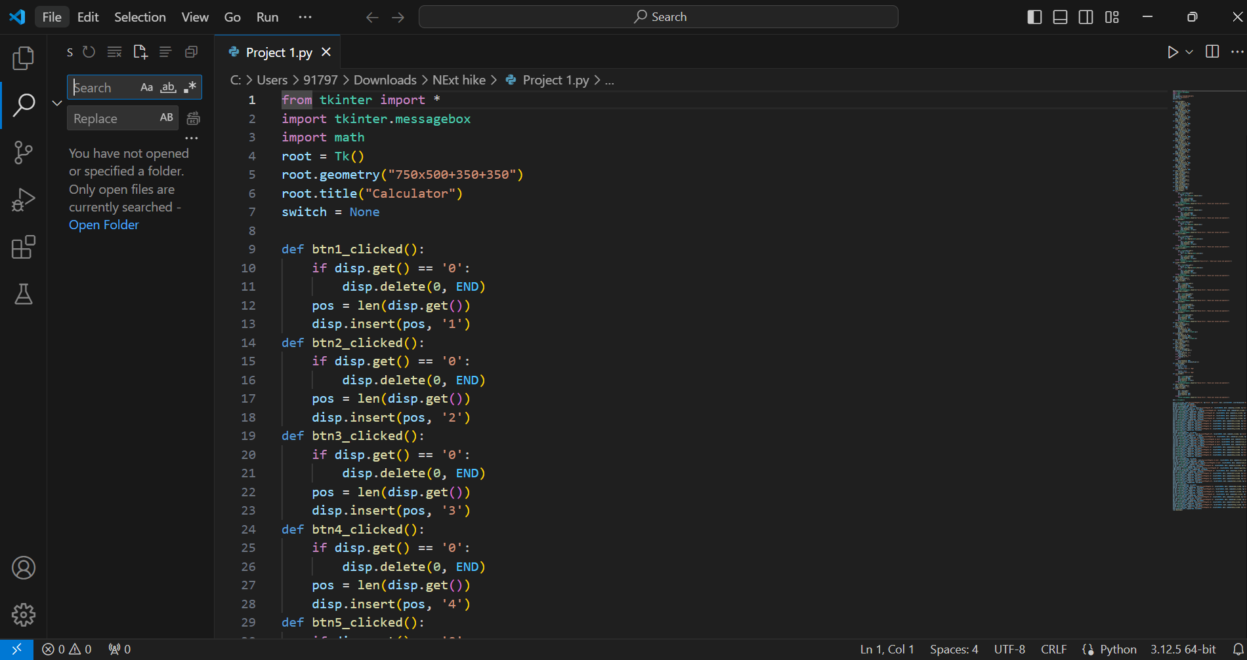
Visual Studio Code
Microsoft created Visual Studio Code, a free source code editor available for Windows, Linux, and macOS. Support for debugging, snippets, code rewriting, intelligent code completion, and embedded Git are among the features. The theme, keyboard shortcuts, options, and extensions that offer more functionality can all be changed by users. Visual Studio Code's python plugin makes it a fantastic video editor.

Slide 8
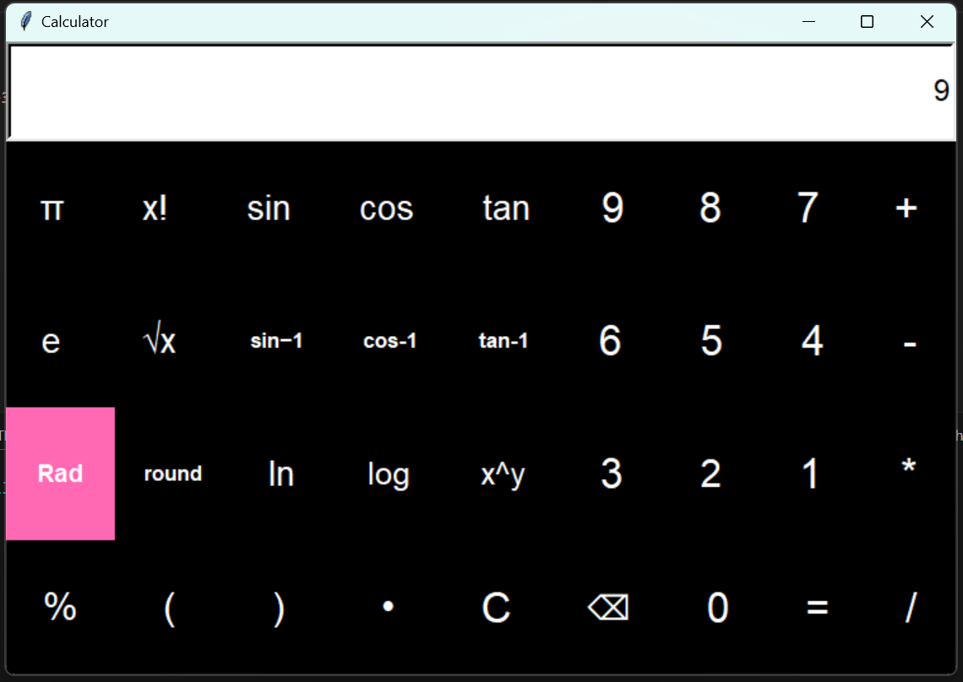
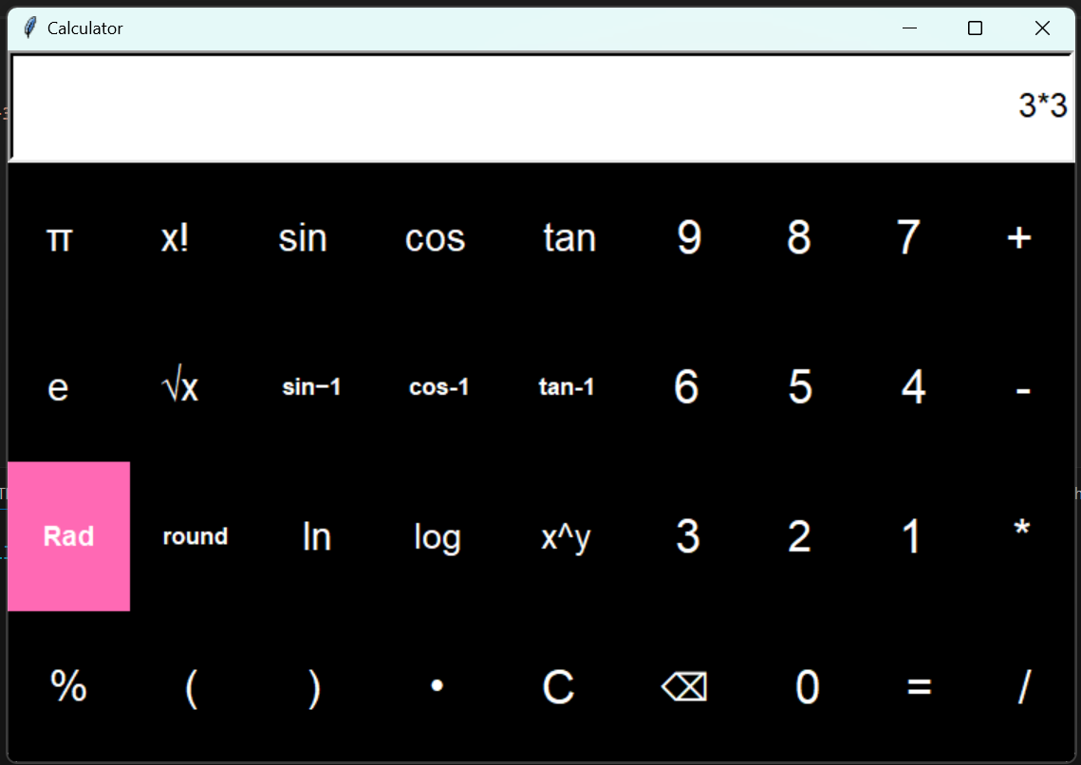
GUI Calculator
INPUT
OUTPUT

Slide 9
Conclusion
The suggested system has no errors. Simple Python language ideas are incorporated into the system. Because the Python Tkinter GUI included a variety of controls, including buttons, labels, and text boxes, it was possible to create an application that was easy for users to navigate. The internet's exponential growth and usage validates the project's enormous potential.

Slide 10
References
Python GUI Programming with Tkinter - Second Edition by Alan D. Moore
28 October 2021
Core Python Programming, by R. Nageswara Rao 1 January 2018

